Slide 1
Accountable Washington
Jennifer tran
Washington state budget & policy center
February 9, 2017

Slide 2
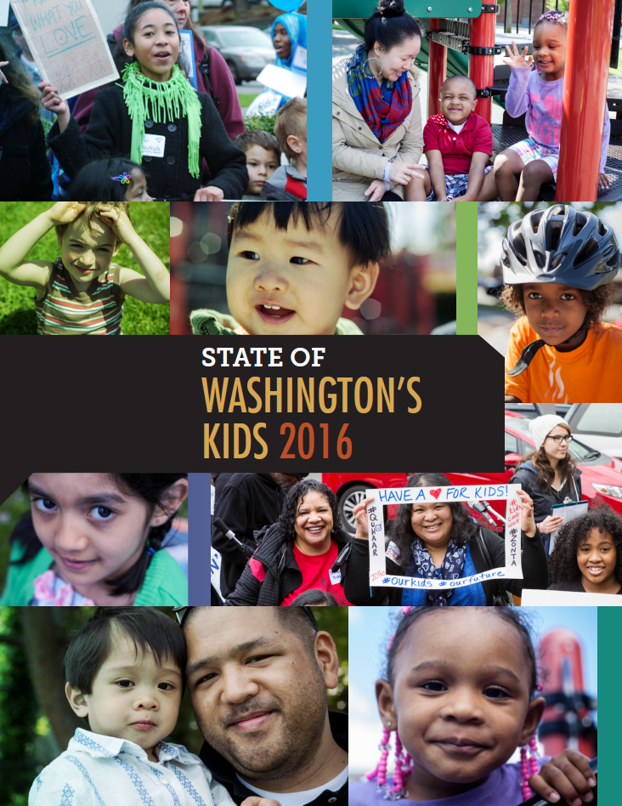
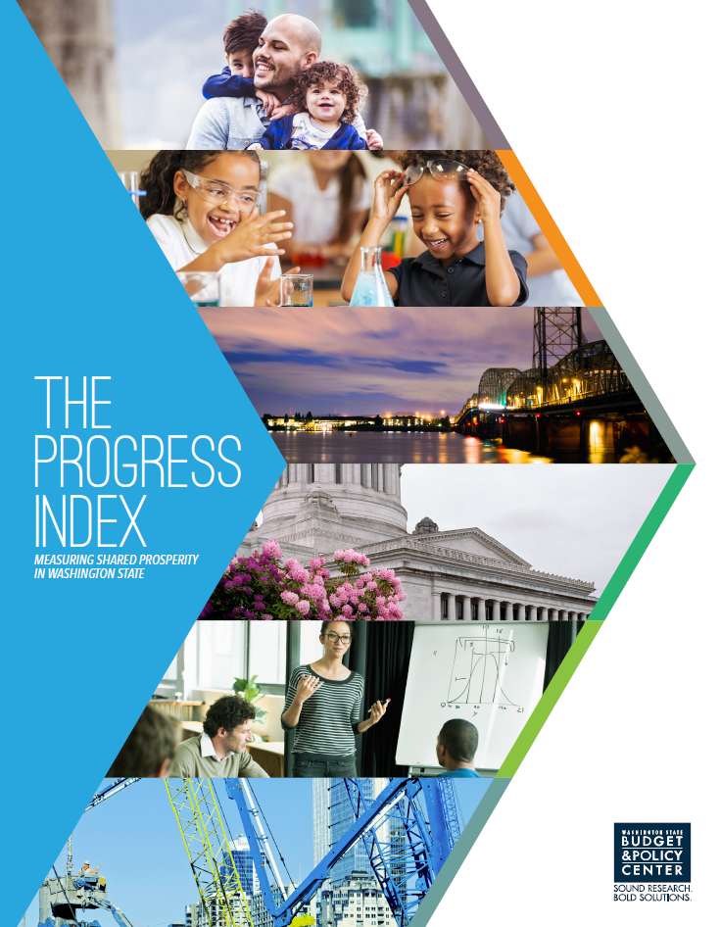
Budget & Policy Center

Slide 3
accountable Washington
Accountable Washington
Offers a bold, equitable path to ensuring our state has investments for all Washingtonians to thrive

Slide 4
accountable Washington
Holds Washingtonians accountable to:
Our kids
Households with middle and low incomes
Our communities

Slide 5
THE CURRENT SYSTEM

Slide 6
Accountable Washington
Goals
Lead with equity
Generate $4 billion per biennium in new revenue for schools and other priorities

Slide 7
Accountable Washington
Raise $4 billion per biennium by:
Safeguarding middle- and lower-income families and seniors.
Eliminating wasteful tax breaks and property tax restrictions.
Rebalancing the tax code with a new capital gains tax on the richest 2 percent.

Slide 8
Accountable washington
Raise $4 billion per biennium by:
Safeguarding middle- and lower-income families and seniors.
Eliminating wasteful tax breaks and property tax restrictions.
Rebalancing the tax code with a new capital gains tax on the richest 2 percent.

Slide 9
Safeguarding working families
Property Tax Safeguard Rebate
Targeted property tax rebate program
Available to households with incomes under $75,000/year
Shuts off property taxes at 2% of household income
More than 40% of Washington homeowners and renters would benefit

Slide 10
Safeguarding working families
Fund the Working Families Tax Rebate (WFTR)
Based on one of the most powerful federal anti-poverty tools
Nearly 440,000 lower-income families received EITC in Washington in 2014
Promotes better health and education outcomes.
Only goes to those who work.

Slide 11
Safeguarding working families

Slide 12
Accountable Washington
Raise $4 billion per biennium by:
Safeguarding middle- and lower-income families and seniors.
Eliminating wasteful tax breaks and property tax restrictions.
Rebalancing the tax code with a new capital gains tax on the richest 2 percent.

Slide 13
Eliminating wasteful tax breaks
Eliminate wasteful tax breaks and property tax restrictions by:
Resetting the state property tax rate
Eliminating the 1% levy growth cap to ensure sustainable resources for schools
Cleaning up wasteful tax breaks

Slide 14
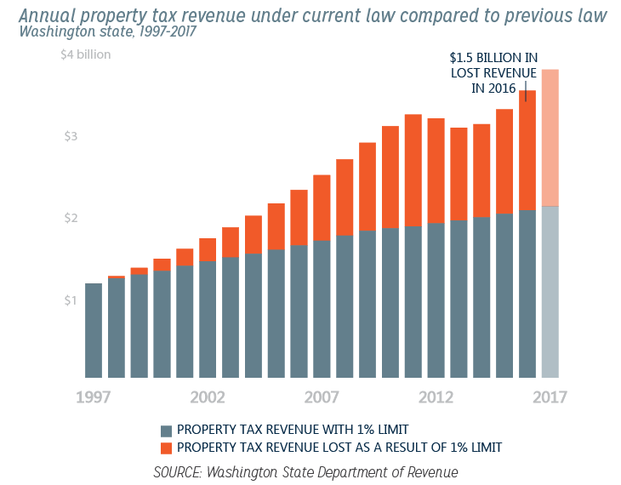
Eliminating Wasteful Tax Breaks
Eliminating the 1% levy growth cap to ensure sustainable resources for schools

Slide 15
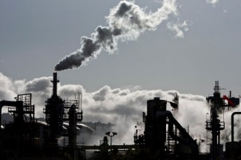
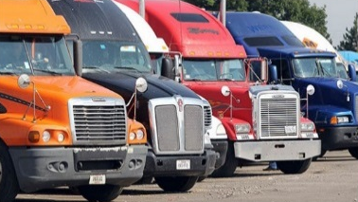
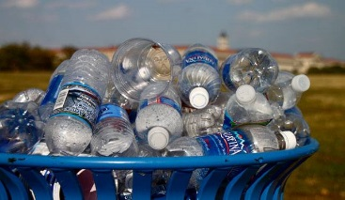
Eliminating Wasteful Tax Breaks
Cleaning up wasteful tax breaks
Luxury vehicle trade-ins: $94 million
Oil refineries: $52 million
Trucking and railing: $57 million
Candy, gum, and bottled water: $127 million
Consumer services: $294 million

Slide 16
Accountable washington
Raise $4 billion per biennium by:
Safeguarding middle- and lower-income families and seniors.
Eliminating wasteful tax breaks and property tax restrictions.
Rebalancing the tax code with a new capital gains tax on the richest 2 percent.

Slide 17
REBALANCING THE TAX CODE
Tax on High-End Capital Gains
Raise resources for schools. Generate $2.8 billion for schools, health care, and other priorities with a 9.9 percent tax rate.
Improve equity. Limit the tax to the richest 2 percent by exempting the first $50,000 ($25,000 for singles) from taxation.
Make the tax code more dependable. Dedicate a portion to the state “rainy day fund.”

Slide 18
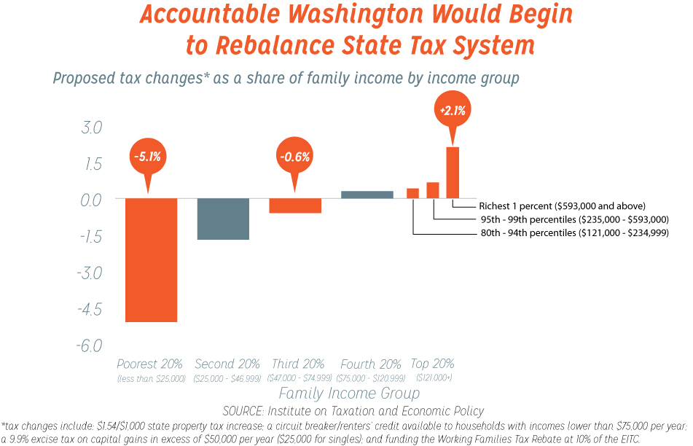
Accountable washington

Slide 19
WHAT CAN YOU DO?
Sign up for schmudget, the Budget & Policy Center’s e-newsletter: www.budgetandpolicy.org
Get involved with All In For Washington, a statewide effort to change the conversation around revenue reform: www.allinforwa.org

Slide 20
COMING UP FROM B&PC
Budget Beat Webinar on Early Learning:
Friday, February 10 from 12:00-12:30
Sign up online: www.budgetandpolicy.org
Kids Count Washington analysis on ECEAP and it’s potential impact on closing the racial equity gap in kindergarten readiness across the state

Slide 21
thank YOU!
Jennifer Tran
jennifert@budgetandpolicy.org
Washington State Budget & Policy Center

