Slide 1
WSA Head Start and ECEAP
Winter Association Meeting
Ross Hunter, Director
Kelli Bohanon, ECEAP/State Pre-K Administrator
February 8, 2017
Notes:
1

Slide 2
DEL’s Vision: By 2020, 90% of five-year-olds will be ready for kindergarten, with race and family income no longer predictors of readiness.
Notes:
2

Slide 3
Racial Equity and Inclusion at DEL
DEL’s statement on supporting diversity and inclusion
DEL’s Racial Equity Initiative – Steps We’re Taking
Develop and implement a comprehensive racial equity strategy.
Develop and continually refine tools and processes necessary to implement the racial equity strategy.
Train and support DEL staff to increase their knowledge, awareness and capacity to lead for equity.
Notes:
3

Slide 4
Minimum Wage Law Effects on ECEAP
Initiative 1433 passed increasing the minimum wage:
$9.47/hour in 2016.
$11/hour on Jan. 1, 2017
$13.50/hour in 2020.
DEL assessing affects on:
ECEAP child and family eligibility.
ECEAP contractor and site level staff.
Other DEL-related effects, like WCCC.
Notes:
4

Slide 5
Effects on ECEAP Child and Family Eligibility Some Policy Considerations
Raise ECEAP eligibility, such as to 130% federal poverty level which would match the school free lunch program?
Keep ECEAP eligibility at 110% federal poverty level and increase the threshold for over-income slots for families with specific risk factors?
Implement a combination of these strategies?
Notes:
5

Slide 6
ESIT Regionalization Plan
Current Funding Structure – Too Complex
Federal $
$$$
Local Lead Agencies
$$$
DEL
$$$
$$$
Providers
$$$
General
Fund $
School Districts
$$$
OSPI
$$$
$$$
Notes:
6

Slide 7
ESIT Regionalization Plan
Reduce from 25 to 12 regions by 2018
Clarify roles of DEL, LLAs, and Providers
Increase direct communication between DEL, LLAs, and Providers
Notes:
7

Slide 8
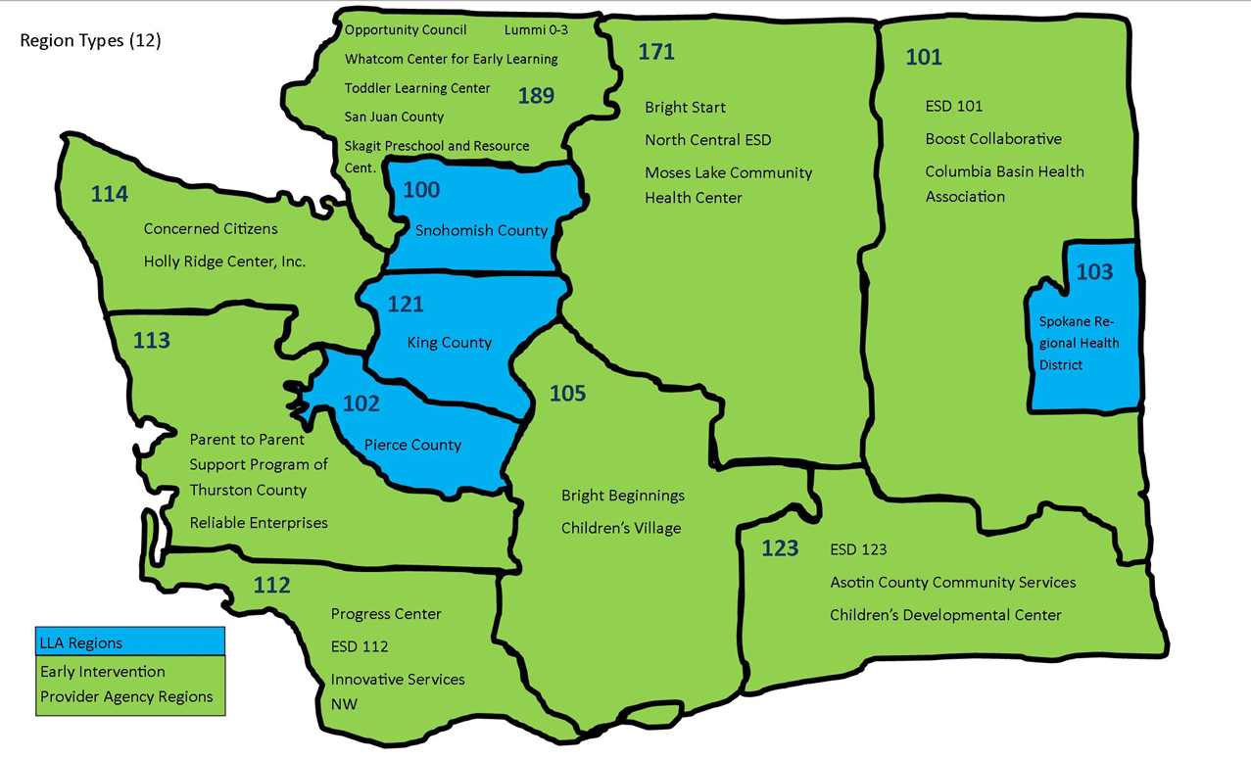
ESIT Regionalization Plan
Notes:
8

Slide 9
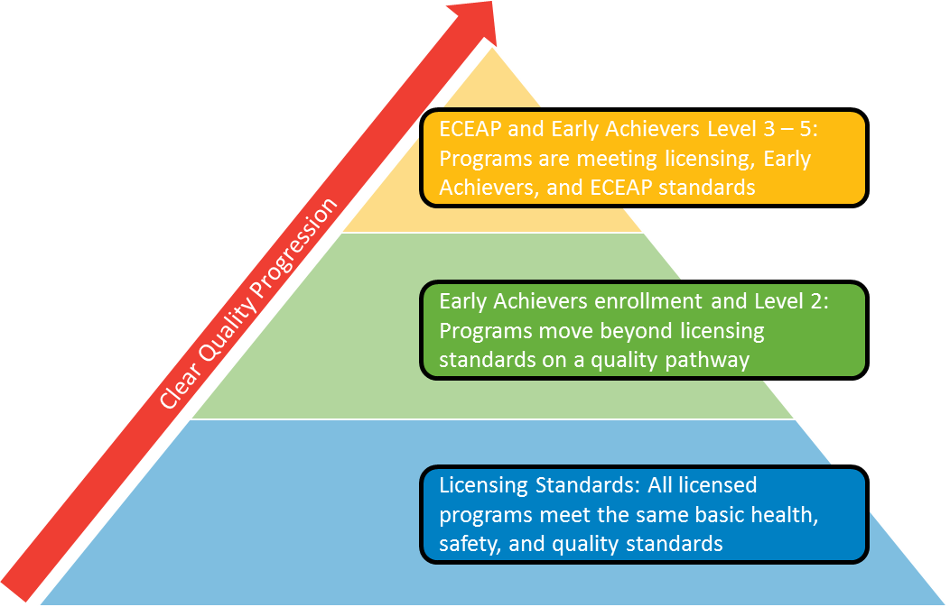
Standards Alignment: One set of standards across all settings that demonstrate a clear progression of quality

Slide 10
ECEAP And Standards Alignment
Early Achievers and ECEAP Standards Progression Goals:
Quality begins at licensing. All sites will meet licensing standards as the foundation of quality.
Standards are clear and measurable.
Standards provide steps for quality growth from licensing to Early Achievers and ECEAP without duplication and with similar language.
Providers can see how quality increases in the standards from licensing through ECEAP. Expectations and next steps for participation in quality growth are clear.
Notes:
10

Slide 11
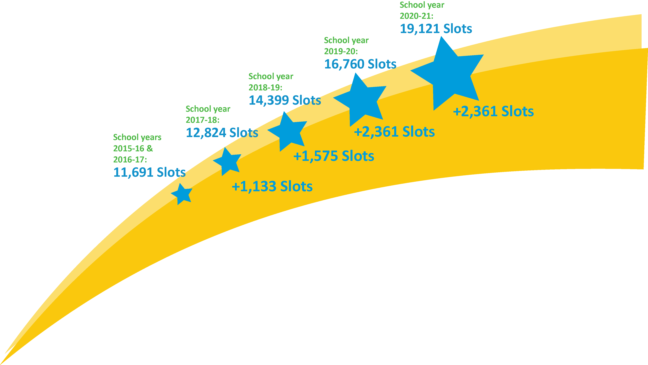
ECEAP Expansion
Slots needed for statutory entitlement

Slide 12
ECEAP Expansion Planning
Vision:
ECEAP is one of DEL’s core strategies for very low-income and at-risk children.
ECEAP’s expansion efforts must be grounded in securing sufficient resources and prioritizing components that we know (from data and research) have the most impact on children experiencing poverty and a multitude of other risk factors.
Notes:
12

Slide 13
ECEAP Expansion Prioritizing Components of Expansion
ECEAP child outcomes data
Leading with a racial equity lens
Key research/evidence
Stakeholder engagement and feedback
Data and information gathered through projects and initiatives
Political/advocacy landscape
Notes:
13

Slide 14
ECEAP Expansion: 2017-2021
90%
Facilities
Slot
Conversion
Quality
90% of children
ready for kindergarten
Expansion
of Slots*
Summer
programming
Slot Rate
Increase**
DEL
Alignment
Project
Race and income eliminated as predictors of success
Workforce
Eligibility
ECEAP
Readiness/
Capacity
Building
Contracting
*Full School Day and Extended Day
**Cost of Quality
Racial Equity Lens Applied Throughout Expansion
Notes:
Kelli

Slide 15
ECEAP Expansion Current Status and Work Underway
Governor’s budget 2017-19 (slot rate increase, slot expansion, summer programming, capital request)
ECEAP Pathways Project for Child Care
DEL Cost of Quality research
DEL Alignment Project: ECEAP Performance Standards revisions
Planning with OSPI for K-12 readiness work
ECEAP slot surveys
Notes:
Kelli
15

Slide 16
ECEAP Expansion Key Next Steps and Actions
Expansion Think Tank
Contracting/Subcontracting Workgroup
Revised Saturation Study and Plan for Slot Expansion
Notes:
16

Slide 17
Expansion Think Tank Purpose/Charge
Provide insights and advice about obstacles to becoming an ECEAP provider and how to overcome them
Serve as a venue to explore potential changes to ECEAP processes that can support expansion of high-quality ECEAP services along the legislatively-mandated timeline
Will operate several “workgroups” on topics critical to ECEAP expansion
Notes:
17

Slide 18
Expansion Think Tank Membership
35 members
Broad group of current and potential contractors, subcontractors, parents and other key partners
Notes:
18

Slide 19
Contracting/Subcontracting Workgroup
Charge: Provide insight and advice regarding changes to ECEAP contracting and subcontracting processes, tools and documents
Membership: Established with a smaller set of members than the Think Tank to allow the group to work efficiently and effectively. Broad group of current and potential contractors, subcontractors, parents and other key partners
Notes:
19

Slide 20
ECEAP/Head Start Saturation Study Key Revisions and Next Steps
Purpose and Availability
Methodology
Priority Groupings
Use of Saturation Study in Expansion Planning
Notes:
20

Slide 21
Questions?
Notes:
21

