Slide 1
Advocating for and with people with intellectual and developmental disabilities since 1936
Notes:
My name is Stacy Gillett and I am the Executive Director of The Arc of King County. The Arc is an advocacy organization for people with intellectual and developmental disabilities.

Slide 2
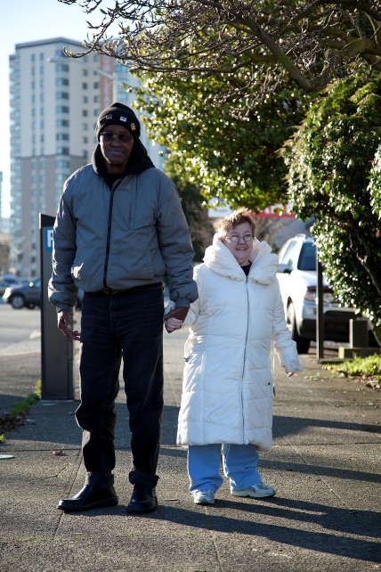
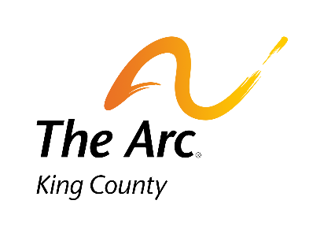
Our History
Founded in 1936, The Arc of King County is the oldest non-profit serving individuals with intellectual and developmental disabilities and their families in the Puget Sound area and is one of the oldest such non-profits in the United States.
It is an affiliated chapter of The Arc of Washington and The Arc of the United States.
Notes:
The Arc promotes and protects the human rights of people with intellectual and developmental disabilities and actively supports their full inclusion and participation in all aspects of society throughout their lifetime, believing this is a fundamental moral, civil and constitutional right. The Arc was founded by families who wanted a their loved one to be integral to their homes and communities, not living in institutions. There are over 700 state and local chapters of The Arc across the country.

Slide 3
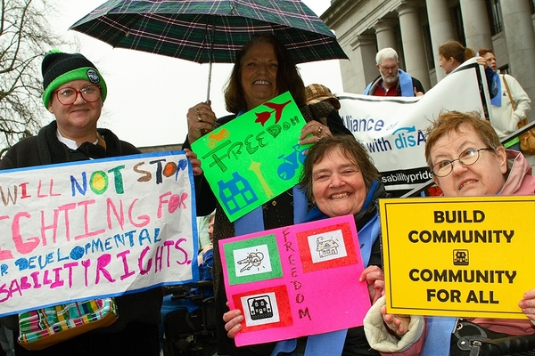
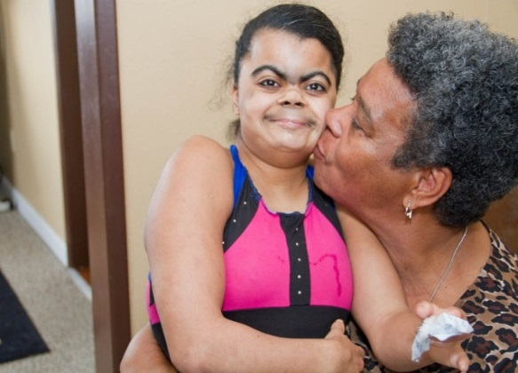
Our Mission and Vision
Advocating for the right of children and adults with intellectual and developmental disabilities and their families to live, learn, work and play in the community– improving the quality of life for us all.
A world where individuals with intellectual and developmental disabilities thrive as equal, valued and active members of the community.
Notes:
The Arc provides advocacy, information and referral, residential services, representative payee services and peer mentoring support so that people with I/DD of all ages can access education, employment, health care, housing, transportation, legal justice, and civil rights. People with developmental disabilities include cerebral palsy, epilepsy, autism, Down Syndrome, and other neurological conditions that occur before the age of 18, will continue indefinitely, and result in substantial limitations to one’s adaptive and functional skills.

Slide 4
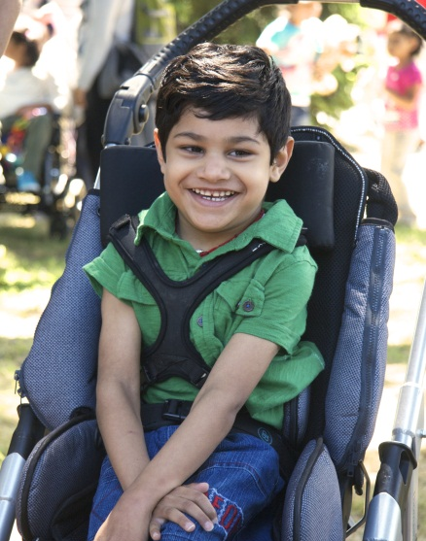
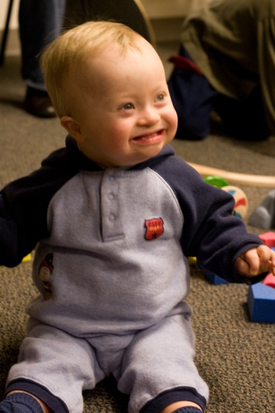
For Young Families
Parent to Parent/Helping Parent
Information & Referral in all languages
Individual Advocacy to
address access to
education, employment,
early intervention, and
health care
King County Parent and
Family Coalition
Wings for Autism
Legislative Advocacy
Arc Leadership Initiative
Notes:
Learning your child has a disability can be daunting for any new parent. The Arc connects young families with valuable information, resources, and other families to help them navigate and advocate for their needs and the needs of their child. We match young parents with mentors and invite them to play dates and gatherings. We provide child care during educational opportunities so parents can learn skills and take a break! We connect them to services and offer support and advice when they are struggling with issues and transitions. We help them find professionals who can help their children be healthy and engaged, and preserve and support their family unit. We work closely with the Birth-to-3 Centers, helping families with their transition to the school system, and work with physicians and hospitals to ensure families have a safety net of support. We help families learn how to navigate systems themselves, and fly the friendly skies – our most recent collaborations have been with Alaska Airlines and the Port Authority to train personnel to be sensitive to the needs of families whose child may have autism, and to help families see that their world can be as big as they want to imagine.

Slide 5
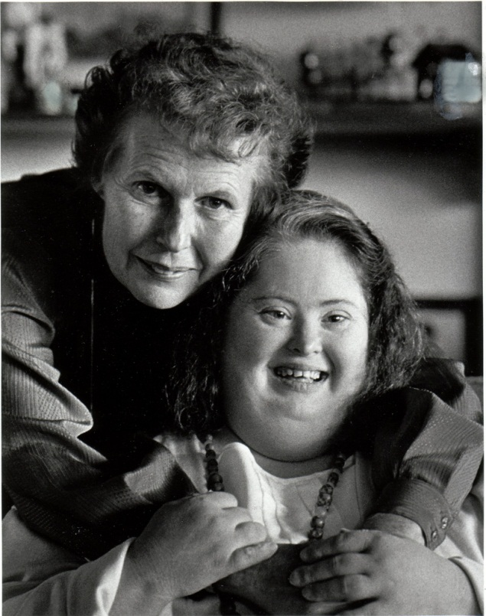
For Families of Adults
Information & Referral in all languages
Individual Advocacy to access employment, housing, transportation,
health care, public benefits, public education
Senior Family Caregiver Support
Parent and Family
Coalition
Supported Living Services
Legislative Advocacy
Arc Leadership Training
Notes:
The Arc helps families access respite, personal care and individual family support services provided in the home, public benefits, housing, public education and employment. For senior families and adult siblings who are involved in the care of adults with disabilities, we provide comprehensive information and referral services, trainings and family gatherings. We connect people with I/DD to assistive technology and other innovations that remove barriers to living independently.

Slide 6
For Adults with Disabilities
Self Advocacy
Information & Referral
Representative Payee
and Support Services
Legislative Advocacy
Supported Living for Independent adults
The Arc Leadership Initiative
Notes:
We believe that adults with intellectual and developmental disabilities have the right to make their own decisions and receive the support they need to live inclusive lives within the community. “Self advocate” is a term born out of the civil rights movement which refers to people with I/DD taking control of their own decisions and lives, being in charge of their own care, speaking up for themselves and not being under undue influence or the control of others. People with I/DD are often some of the most powerless members of society. They are extremely vulnerable to abuse, neglect, and social and physical isolation. For many years people with I/DD lived in institutions where they had little or no control over their living conditions in largely staff-directed environments. The self-advocacy movement seeks to reduce the isolation of people with disabilities and give them the tools to experience greater control over their lives and decisions. The Arc supports self-advocates to talk to policy-makers, legislators, the agencies that play a role in their lives, and exercise their voices.

Slide 7
Outreach and Advocacy
Individual and Family Support
3,363 Contacts by email, phone and in-person meetings
75% of parents surveyed felt less isolated after Parent-to-Parent interactions
Majority of I&R calls and requests for help are from parents. 10% from self-advocates. 22% Professionals, siblings, friends, and other relatives
4,031 Active participants in online Parent-to-Parent Support groups
Over 150 Education and Peer Support Events
129 Active Parent Mentors
workshops in Spanish and Vietnamese
Notes:
Interacting with Law Enforcement, Strategies for Behavioral Support, Guardianship, Special Needs Trusts, Public Benefits, Special Education,

Slide 8
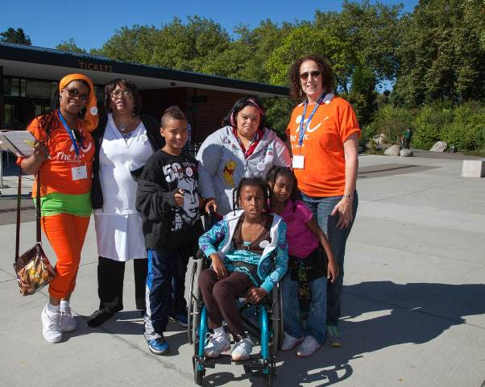
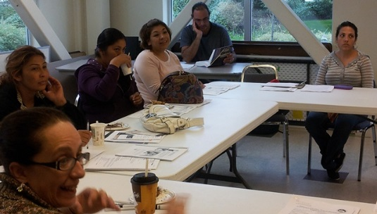
For Multicultural Families
Through our multicultural support, we provide information, referral, parent-to-parent counseling, and legislative advocacy to people with diverse cultural and language backgrounds:
African American Families
Latino Families
Somali Families
Vietnamese Families
Notes:
The Arc provides intentional support for the whole child and family through bilingual information and referral and individual advocacy, community-based trainings, family gatherings and multicultural leadership trainings and advocacy. Begun as a part of a large federal grant – we continue to employ support staff and have many volunteers who are a part of diverse language and cultural communities we serve – and help to navigate a very complex and daunting system.

Slide 9
Legislative Issues
Young children need early intervention services equitably across the state;
Students with disabilities need equitable access and inclusion in the education system;
Families need crisis respite and support services;
Graduating young adults need employment services;
Adults with disabilities need stable community-based supported living services.
The system should provide an equitable and culturally competent system of support, including access to bilingual/bicultural services, trained interpreters and translations for limited-English speaking individuals and families;
The system must address the unserved and underserved to reduce crisis

Slide 10
Working Together Collectively
Partnerships
Collaborations
Asian Counseling and Referral Services
East African Community Services
Lutheran Community Services
Washington State Father’s Network
Birth to Three Centers
Seattle Children’s Hospital
Open Doors for Multicultural Families
Special Olympics
Seattle Public Schools
Highline, Bellevue, Seattle Special Needs PTSAs
National and State Arc with Chapters across the country
Developmental Disabilities Administration (DDA)
Washington State Developmental Disabilities Council
King County Board for Developmental Disabilities
University of Washington Center for Excellence in Developmental Disability (UCEDD)
Washington State Legislators
Notes:
The Arc works closely with Special Needs PTSAs, public schools, the Father’s Network, multicultural community centers and nonprofit organizations, churches, synagogues, mosques and local shelters and housing authorities to ensure that we are available to anyone who needs our services and to connect families and people with I/DD with the services they need to live in their communities. Parent/Family coalitions across the state and have received national recognition for their work changing policy and legislation that improves the lives of people with I/DD. We work with the state and county agencies, and we work for future change collaborating with the DDC, UCEDD and Disability Rights Washington on right protection and social and legal justice for people with I/DD.

Slide 11
Changing Attitudes
Time to Change
Relationships Matter
Nearly half of the U.S. adult population say they do not know a single person with I/DD
2 in 5 Americans don’t know what an intellectual disability is
91% of Americans would terminate a pregnancy if told their child would have I/DD, mostly out of fear they couldn’t emotionally handle the situation
56% of Americans feel it is not offensive to refer to someone as “retarded” when they make a mistake
Of those adults who know someone with an I/DD, their expectations were higher for lifelong achievement
Just under ½ of the U.S. adult population that does not know someone with I/DD cling to old judgements and dated stereotypes and confusion about I/DD
Younger Millenial Women know more people with I/DD and are more positive in their views of inclusion than older Americans
Notes:
Exclusion and Isolation perpetuate myths about people with I/DD. Better, stronger, more compassionate country if we include and value everyone in it.

Slide 12
Where did Special Education Come From?
“Washington State institutions shall be free to residents age 6-21 years who are feeble-minded, idiotic, or epileptic or who are physically defective, and free of loathsome and contagious diseases….
…to such an extent that by reason of defective intellect are unfitted for companionship with other children and rendered unable to acquire an education or training in the common schools….
…may be segregated and admitted pursuant to the rules of the Department…..”
RCW 72.28.020, chapter 173

Slide 14
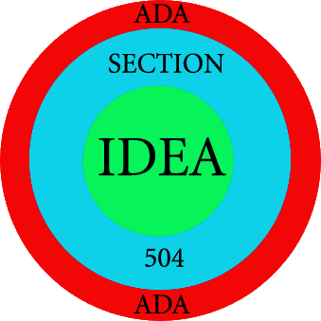
Relationship between Civil Rights Law and the IDEA

Slide 15
Fundamental Principles of IDEA

Slide 16
IDEA Eligibility Categories
Intellectual disability
Hearing impairment (including deafness)
Speech or language impairment
Visual impairment (including blindness)
Emotional behavioral disability
Orthopedic impairment
Autism
Traumatic brain injury
Other health impairment
Specific learning disability
Deaf-blindness
Multiple disabilities
Developmental delay (for students 3-8 years of age)

Slide 17
Eligibility
“……and who, because of the disability and adverse educational impact, has unique needs that cannot be addressed exclusively through education in general education classes with or without individual accommodations, and needs special education and related services.”

Slide 18
Evaluation Must Address
Academic, developmental and functional needs of the child
ANY BEHAVIOR that impedes the child’s learning or that of others

Slide 19
Independent Evaluation
Second Opinion
By a professional outside the school system
Paid for at public expense

Slide 20
Individualized Education Plan (IEP)
Strengths of the Child
Concerns of the Parent
Results of Evaluation (Current Level of Performance)
Academic, developmental and functional needs of the child
ANY BEHAVIOR that impedes the child’s learning or that of others
Strategies to address behavior, including POSITIVE behavioral interventions, strategies and supports
Limited English proficiency
Braille
Language and Modes of Communication
Assistive Technology DEVICES and SERVICES
Goals (and Objectives)
Evaluative Criteria

Slide 21
IEP Must Include
Statement of the specific educational services to be provided
Extent to which the child will participate in regular educational programs
Transition Plan for students age 16 or younger if appropriate
Positive Behavioral Supports

Slide 22
FAPE How Much Is Enough?
Free – At no cost to the parent
Appropriate – more than minimal progress
Public – At public expense in the public schools
Rowley Decision Still Rules

Slide 23
Least Restrictive Environment (LRE)
Isn’t this a “continuum”??
School districts place in conflict access to the general education setting and an appropriate education
504 modifications can be in the IEP and both general and special education settings must be addressed as part of the IEP
Behavior that interferes with learning must be addressed
Placement in a school as close to the child’s home as possible or in the school the child would attend if not a child with a disability

Slide 24
What’s the Problem?
IEP
Have all needs been identified through evaluation?
Are desired goals and services agreed to?
Has the scope and type of services been identified and agreed to?
Implementation
Does the IEP clearly articulate goals and services?
Has there been a gap in start dates, staffing, provision of services?
Has the process been violated?
Has the child been out of school because they lack services?

Slide 25
MEDIATION
Sound Options
http://soundoptionsgroup.com/our-services/conflict-engagement/mediation/#specialed
By phone
Seattle Area: 206.842.2298 Toll Free: 800.692.2540
Governor’s Office of the Education Ombudsman (OEO)
Toll-free: 1-866-297-2597 www.governor.wa.gov/oeo

Slide 26
Administrative Complaints
Free
Citizen’s Complaint – OSPI
http://www.k12.wa.us/SpecialEd/DisputeResolution/default.aspx
Office of Civil Rights
(206) 607-1600

Slide 27
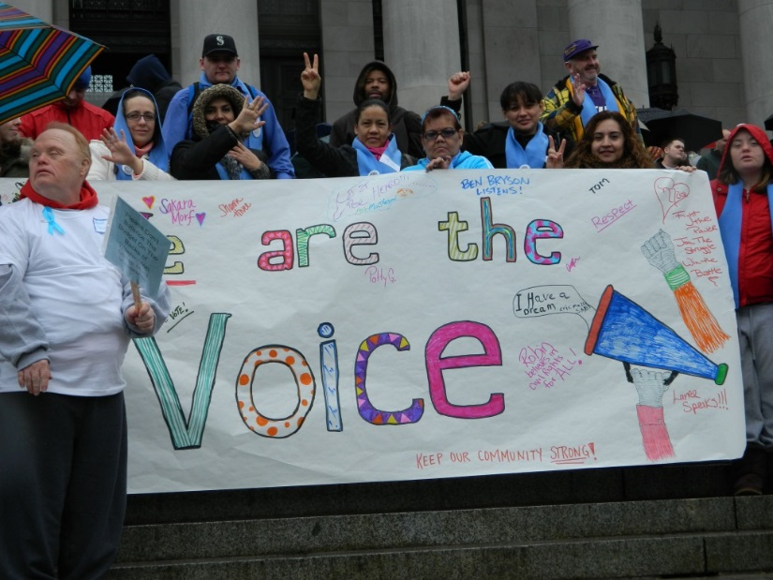
Together We Can Achieve
What we want for ourselves, we want for everyone.
Notes:
Through the simple act of listening to the wants and needs of individuals with I/DD and their caregivers and families, we are able to gauge the needs of the disability community. Through our relationships with community-based organizations, government entities and foundations, we give voice to the needs of people with I/DD and their families and caregivers.

Slide 28
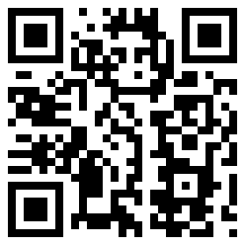
For More Information
Website: www.arcofkingcounty.org
General
Office:
206-364-6337
Information & Referrals “Hotline”:
206-829-7053
Email us a Question:
ask@arcofkingcounty.org
Notes:
Our services are accessed initially by contacting us – either by phone or via email. We welcome any referrals and have an intake process that is open to all cultures, using a language line to ensure we can speak to anyone in any language. Please contact with any question related to someone with I/DD, or who you think may have I/DD. We are happy to help.

